Slide 1
End-to-End Sales Insights Project
23MCI10207
23MCI10191
SUBMETED BY:
Abhishek kumar

Slide 2
PROJECT DETAIL
Project Title | Analysing Amazon Sales Data
Technology | Business intelligence
Domain name | E-Commerce
Project Difficulties Level | Advanced
Tools | Tableau, MySQL

Slide 3
OBJECTIVE
Finding Sales & Sales Trend month wise , year wise , yearly month wise

Slide 4
PROBLEM STATEMENT
Sales management has gained importance to meet increasing competition and the need for improved methods of distribution to reduce cost and to increase profits. Sales management today is the most important function in a commercial and business enterprise.
Do ETL : Extract-Transform-Load some data and find for me Sales-trend -> month wise , year wise , yearly-month wise.

Slide 5

ARCHITECTURE
Real World
Data Pre-Processing
Raw Data Collection
Importing Database MYSQL
Load Data
Missing Value Imputations
Handling Outliers
Data Cleaning
Deployment
Insights
Tableau Desktop
Modelling
Exploratory Data Analysis (EDA)
Reporting
Low-Level Design Document
High-Level Design Document
Architecture Document
Wireframe Document
Detailed Project Report

Slide 6
DATABASE INFORMATION
SALES
CUSTOMER
DATE
MARKET
PRODUCTS
TRANSACTIONS

Slide 7
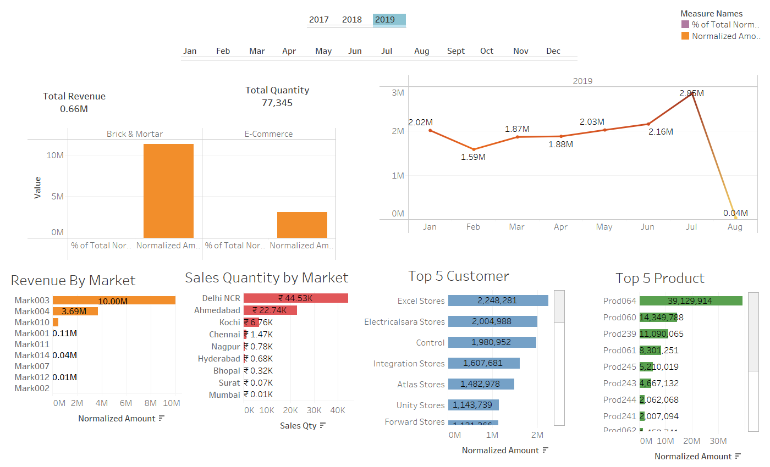
DASHBOARD

Slide 8
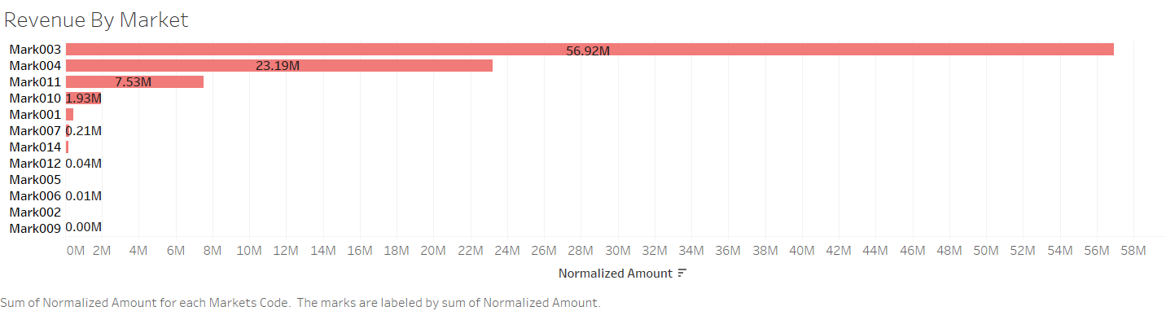
REVENUE BY MARKET

Slide 9
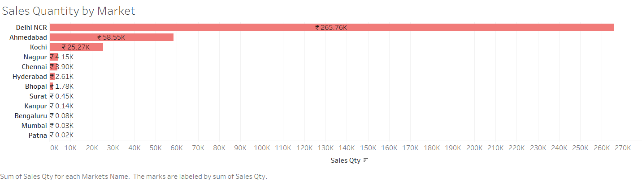
SALES QUANTITY BY MARKET

Slide 10
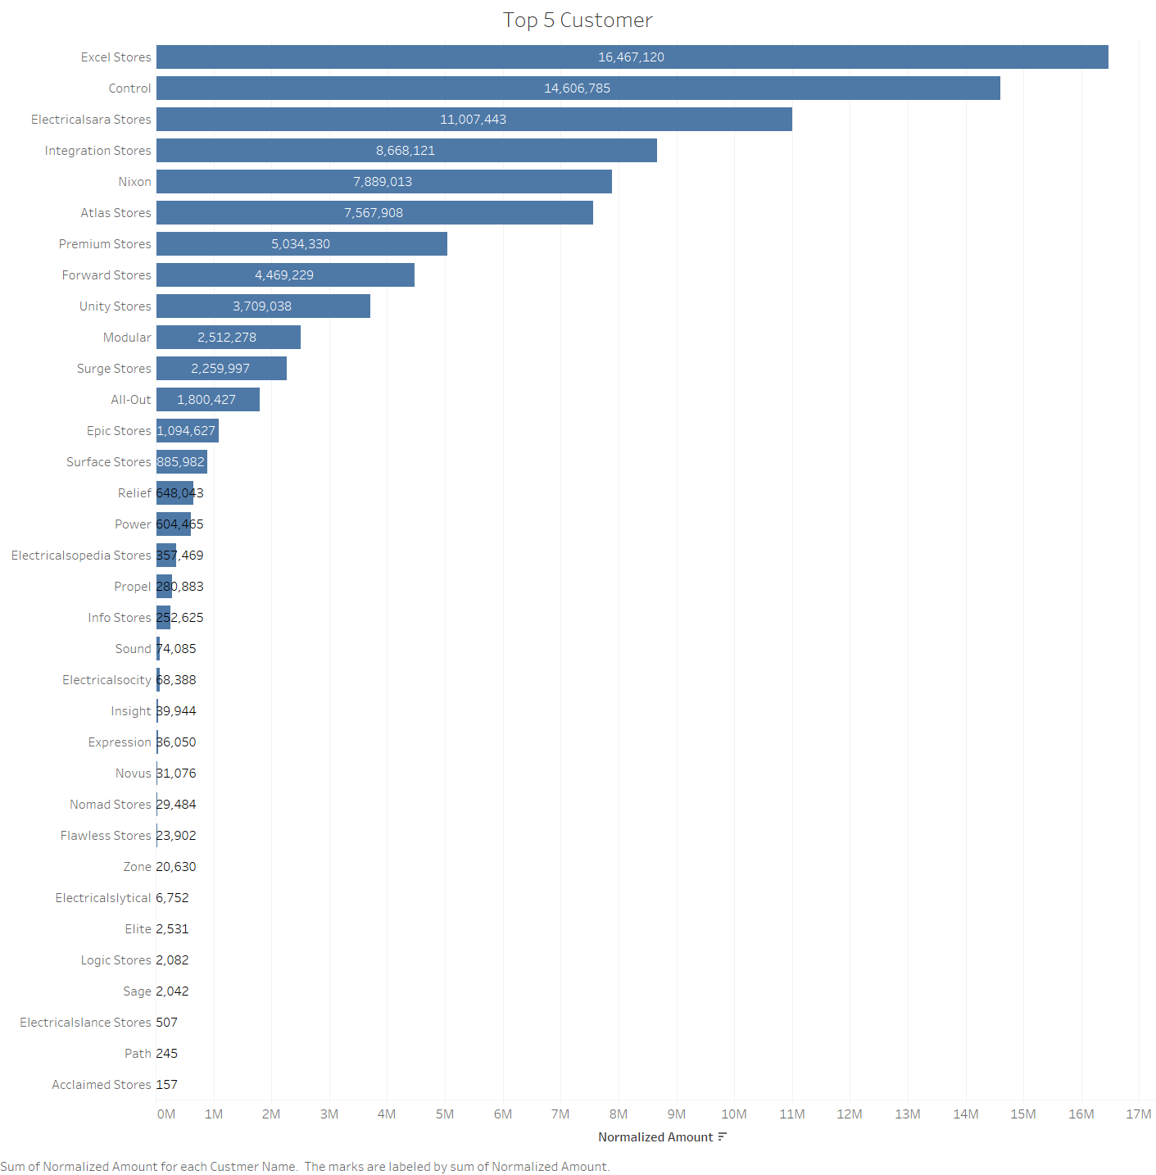
TOP FIVE CUSTOMER DETAILS

Slide 11
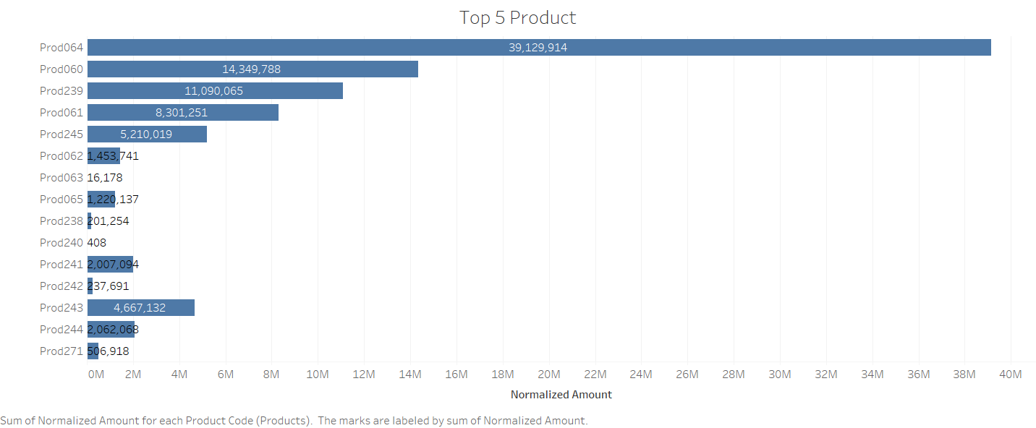
TOP FIVE PRODUCT DETAILS

Slide 12
THANK YOU

